Slide 1


Introduction to Linear Discriminant Analysis (LDA)
Linear Discriminant Analysis (LDA) is a powerful statistical technique used for classification and dimensionality reduction. It aims to find linear combinations of features that best separate different classes of data.
by Dr. Mahammad Shabana

Slide 2
Assumptions and Prerequisites
1
Multivariate Normal Distribution
2
Equal Covariance Matrices
3
Labeled Training Data
LDA assumes that the data in each class follows a multivariate normal distribution.
The covariance matrices of the different classes must be equal for LDA to perform optimally.
LDA requires a labeled training dataset to learn the discriminant functions.

Slide 3
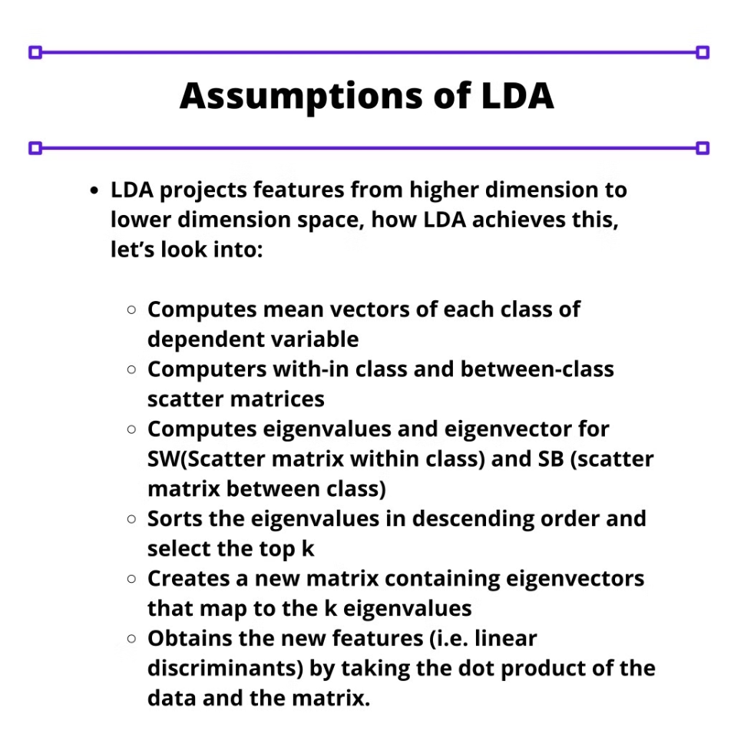

Slide 4
The Discriminant Function
Linear Combination
Projection
Classification
LDA finds the linear combination of features that maximizes the separation between classes.
Data points are projected onto the discriminant function, which acts as a decision boundary.
New data points are classified by their proximity to the projected class centroids.

Slide 5
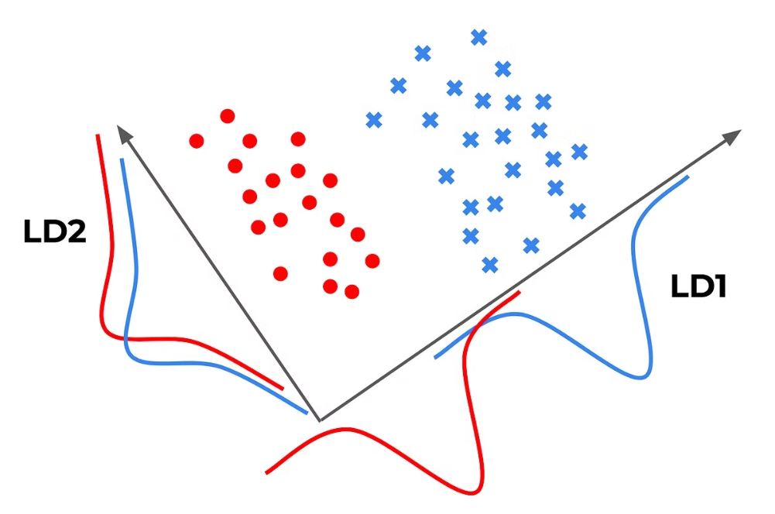

Slide 6
Dimensionality Reduction with LDA
1
Feature Selection
LDA can be used to select the most discriminative features, reducing the dimensionality of the data.
2
Projection
Data is projected onto the discriminant functions, effectively reducing the number of dimensions while preserving class separability.
3
Visualization
The reduced-dimensional data can be visualized, making it easier to understand and analyze the underlying structure.

Slide 7
Understanding Linear Discriminant Analysis (LDA)
Linear Discriminant Analysis (LDA) is a powerful supervised learning algorithm used for classification tasks in machine learning. It is a dimensionality reduction technique that aims to find a linear combination of features that best separates different classes of data. LDA works by projecting the data onto a lower-dimensional space that maximizes the separation between the classes, while minimizing the variation within each class.
by Dr. Mahammad Shabana

Slide 8
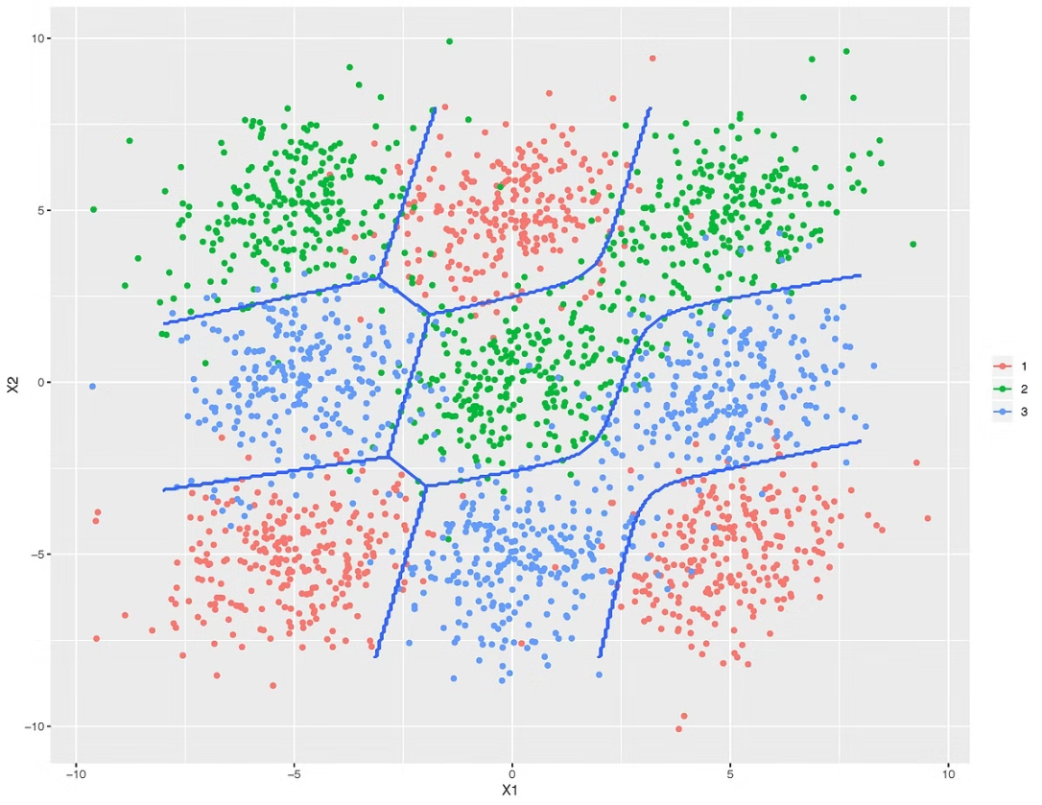

Slide 9
How LDA Works
Step 3: Find Discriminant
Finally, LDA finds the linear discriminant that maximizes the distance between the class means while minimizing the variance within each class. This discriminant line or plane is used to classify new data points.
Step 1: Compute Means
LDA begins by computing the mean of each class in the dataset. This gives it a sense of where the center of each class is located.
1
2
3
Step 2: Compute Variances
Next, LDA calculates the variance within each class. This helps it determine how tightly the data points in each class are clustered around their respective means.

Slide 10
Advantages of LDA
Efficient Algorithm
Handles Multicollinearity
Works with Small Samples
LDA is a simple and computationally efficient algorithm, making it suitable for large-scale applications.
LDA can effectively handle multicollinearity, or correlation between features, in the data.
LDA can work well even when the number of features is much larger than the number of training samples.

Slide 11
Limitations of LDA
1
Gaussian Assumption
2
Equal Covariance
LDA assumes that the data has a Gaussian (normal) distribution, which may not always be the case.
LDA assumes that the covariance matrices of the different classes are equal, which may not be true in some datasets.
3
Linear Separability
4
High Dimensions
LDA assumes that the data is linearly separable, which may not be the case for some datasets.
LDA may not perform well in high-dimensional feature spaces, where the number of features is much larger than the number of samples.

Slide 12
Extensions of LDA
Quadratic Discriminant Analysis (QDA)
Flexible Discriminant Analysis (FDA)
Regularized Discriminant Analysis (RDA)
QDA relaxes the assumption of equal covariance matrices, allowing each class to have its own estimate of variance or covariance.
FDA uses non-linear combinations of inputs, such as splines, to create more flexible decision boundaries.
RDA introduces regularization into the estimate of the covariance matrix, moderating the influence of different variables on LDA.

Slide 13
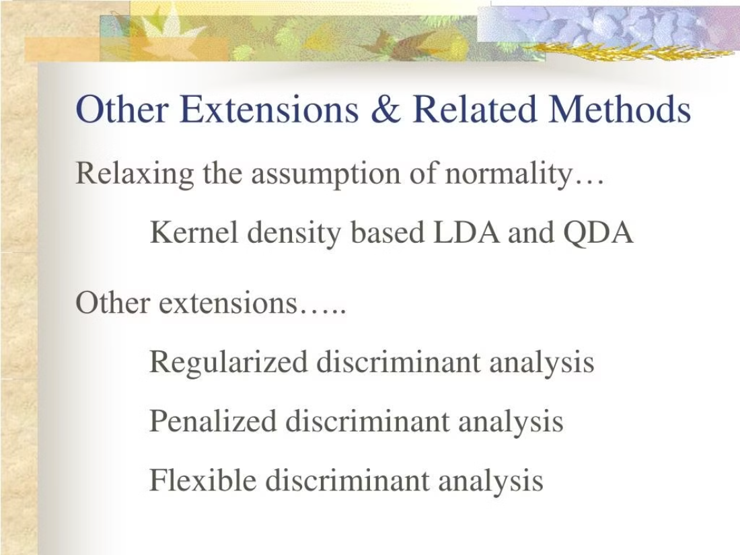

Slide 14



LDA in Action: Face Detection
Face Detection
Eigenfaces
Dimensionality Reduction
LDA is used in face detection algorithms, such as Fisherfaces, to extract useful data from different faces and improve classification accuracy.
When coupled with eigenfaces, a technique that uses principal component analysis, LDA produces effective results in face detection applications.
LDA can also be used as a pre-processing step for dimensionality reduction, helping to reduce the computational cost of machine learning models.

Slide 15



LDA vs. Logistic Regression
Binary Classification
Logistic regression is a popular algorithm for binary classification tasks, but it falls short when dealing with multiple classes.
Multiclass Classification
LDA, on the other hand, is well-suited for multiclass classification problems, especially when the classes are well-separated.
Dimensionality Reduction
LDA can also be used as a dimensionality reduction technique, similar to PCA, to improve the performance of machine learning models.

Slide 16
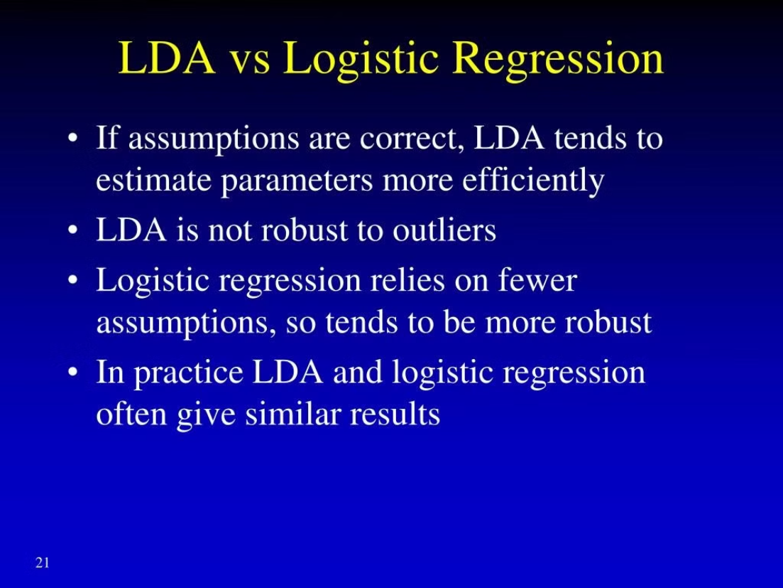

Slide 17
When to Use LDA
Multiclass Classification
LDA is particularly effective when dealing with more than two classes, as it can find the optimal linear combination of features to separate the classes.
Well-Separated Classes
LDA performs best when the classes in the dataset are well-separated, as it can easily find the discriminant that maximizes the distance between the class means.
Dimensionality Reduction
LDA can be used as a dimensionality reduction technique, similar to PCA, to reduce the number of features in a dataset while preserving the most important information.

Slide 18
Advantages and Disadvantages of LDA
Advantages
Disadvantages
Alternatives
LDA is computationally efficient, interpretable, and performs well with linearly separable data.
LDA is sensitive to violations of its assumptions, such as non-normal distributions or unequal covariances.
Quadratic Discriminant Analysis (QDA) and Logistic Regression can be used when the assumptions of LDA are not met.

Slide 19
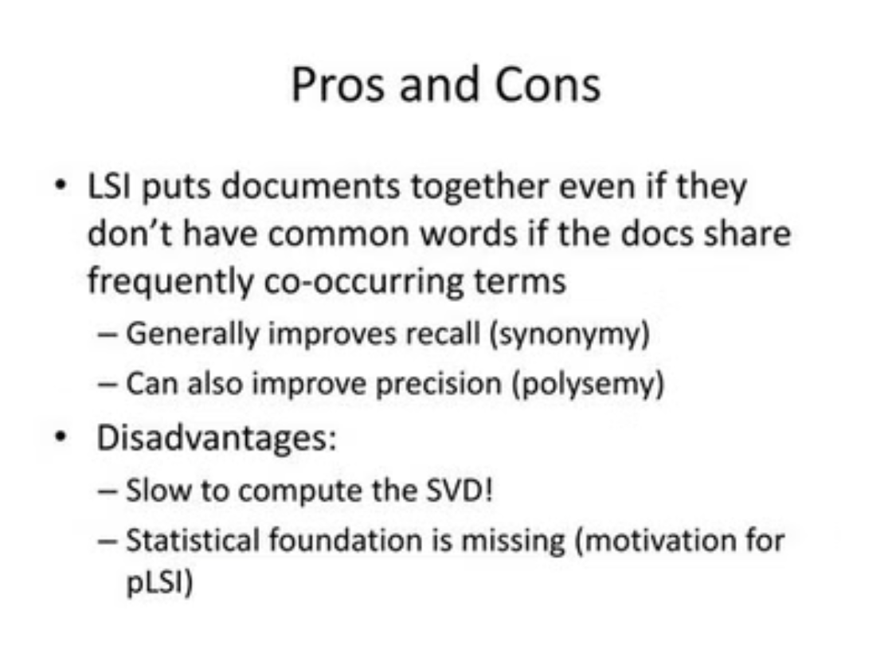

Slide 20




Applications of LDA
Image Recognition
Text Classification
Bioinformatics
Finance
LDA is effective for categorizing text documents into different topics or genres.
LDA is used to analyze gene expression data and classify different types of cancer.
LDA can be used for credit risk assessment and fraud detection in financial applications.
LDA can be used for image classification tasks, such as handwritten digit recognition.

Slide 21
Comparison to Other Classification Techniques
LDA
Logistic Regression
Decision Trees
Support Vector Machines
Linear decision boundary
Probabilistic model
Hierarchical structure
Kernel-based approach
Assumes normal distribution
No distribution assumption
Handles non-linear data
Effective with high-dimensional data
Sensitive to outliers
Robust to outliers
Prone to overfitting
Computationally expensive

Slide 22



Conclusion and Key Takeaways
Linear Discriminant Analysis
Assumptions and Limitations
Comparison to Other Methods
LDA is a powerful classification and dimensionality reduction technique with a wide range of applications.
LDA's performance is dependent on the validity of its assumptions, such as multivariate normality and equal covariances.
LDA has unique strengths and weaknesses compared to other classification algorithms, making it suitable for different types of problems.

